Slide 1
Hacking Videogames For Fun
By
FoxMaccloud

Slide 2
Skills in gamehacking
Memory editing
Assembly editing
Packet editing
Botting

Slide 3
The computer
Operative system
  Winapi
Assembly
  Dissassembe
  Registers
  Stack

Slide 4
External
Pros
  Quick implementation
Cons
  Easy to detect because of open process handle
  Less potential over internal
  Slow

Slide 5
Internal
Pros
  Sick performance
  Much potential
  Hard to detect when done propperly
Cons
  Hard to master
  Easy to detect when not done propperly

Slide 6
Kernel
Pros
  Unlimited power!
Cons
  With great power comes great responsibility!
How to talk with the kernel?

Slide 7
Runtime modifications
Patching
Hooking
  Detour & Trampoline
  IAT/EAT
  VMT
  HWBP
  PageGuard
  Forced Exception

Slide 8
Reverse Engineering
Anti-debug
  IsDebuggerPresent();
Anti-cheat
  All features from Anti-debug
  File & Memory integrity
  String detection
  Obfuscation
  Signatures
  Hook detection
  Virtualization
  Kernel

Slide 9

The Elder Scrolls V: Skyrim
Released in 2011
Remastered in 2016
Offline

Slide 10
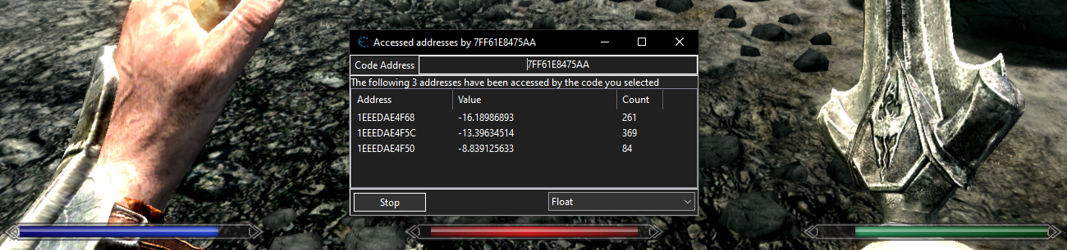
Infinite Stamnia, Health and Magic

Slide 11
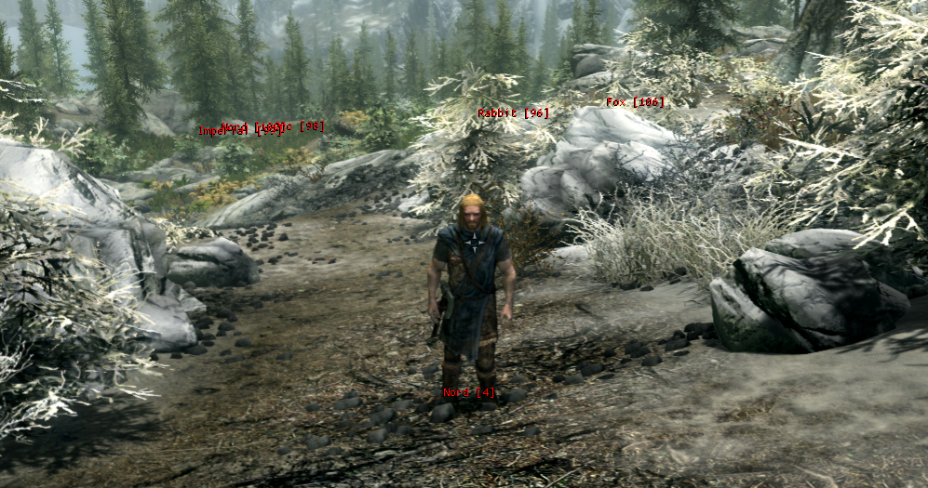
ESP

Slide 12
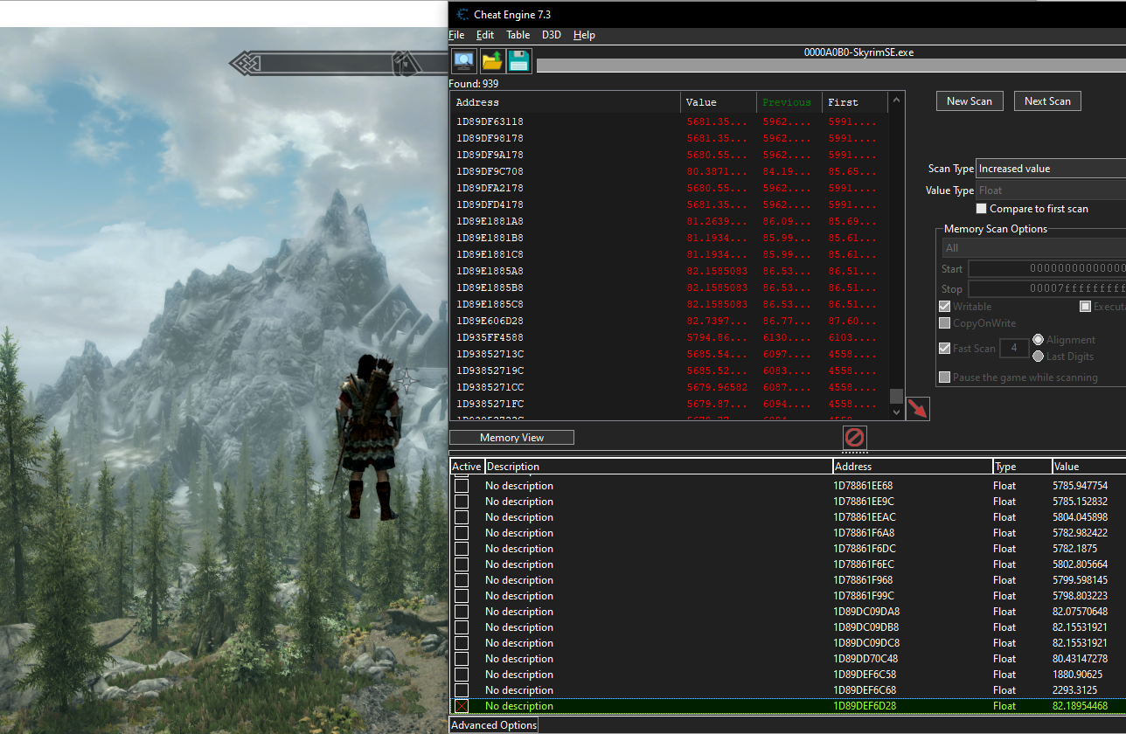
Teleport & Fly hack

Slide 13
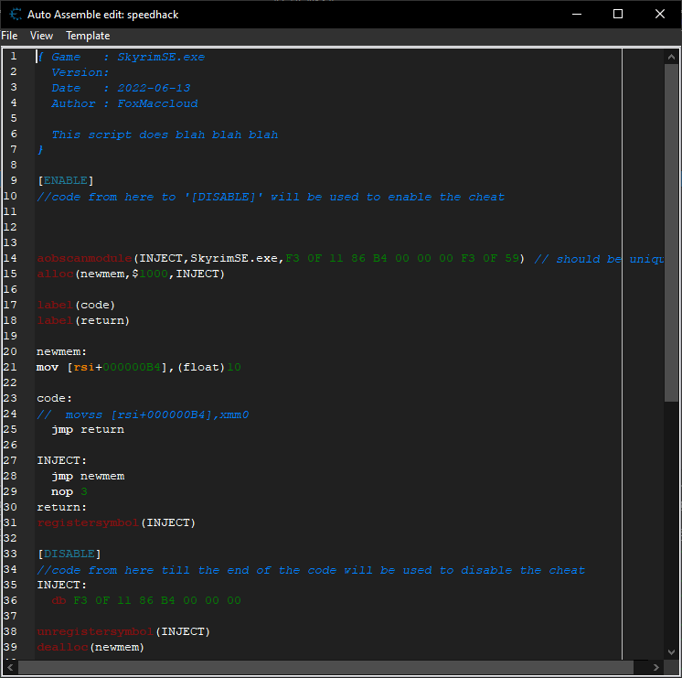
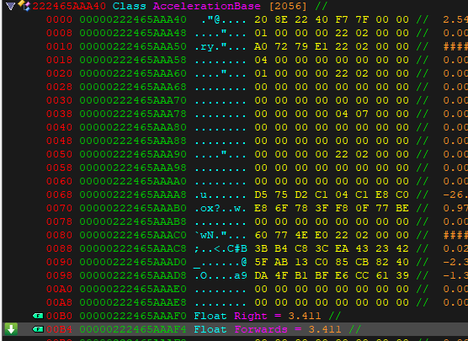
Speed hack

Slide 14
Offline vs Online
Offline techniques may or may not work
Server side validation
Client
Packets

Slide 15
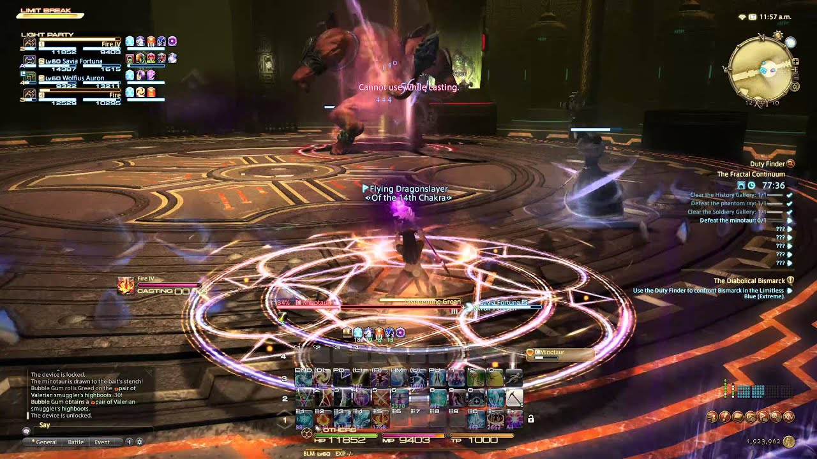
Final Fantasy XIV
Released in 2010
Re-released in 2013
No anticheat

Slide 16
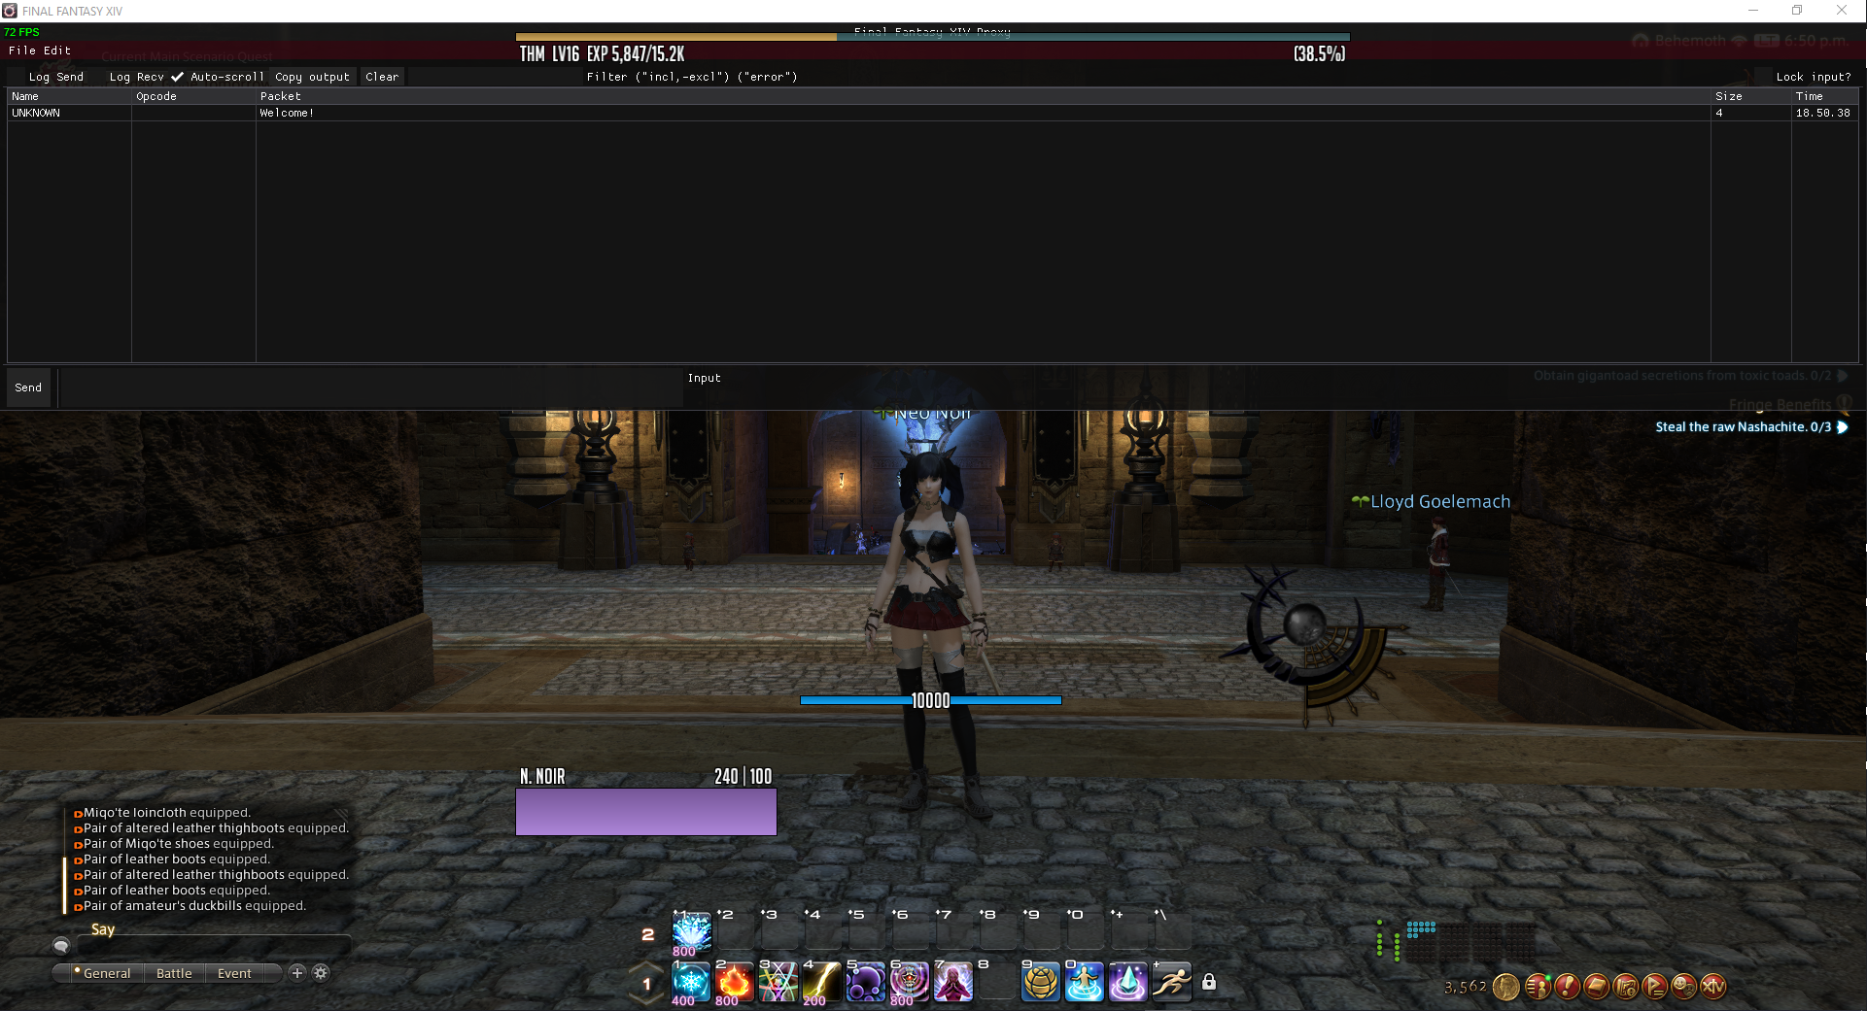
Packet tool
What’s a packet tool?
Buffer encryption

Slide 17
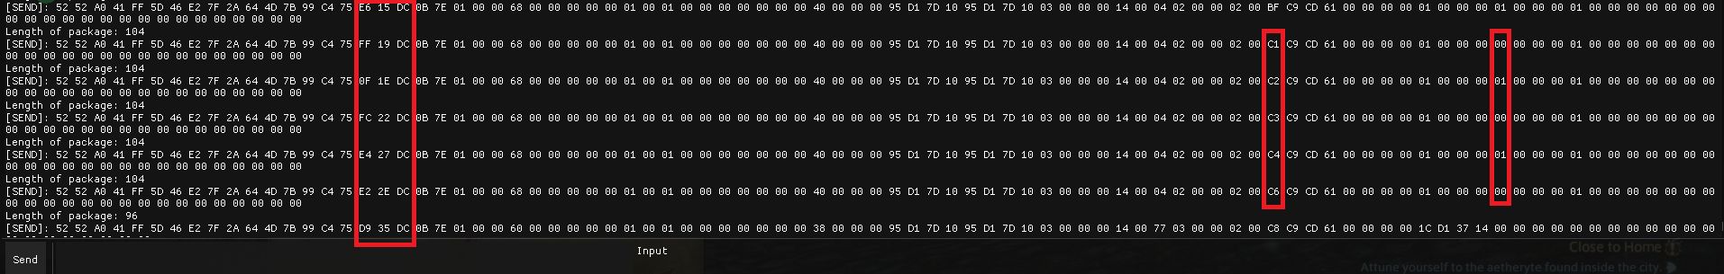
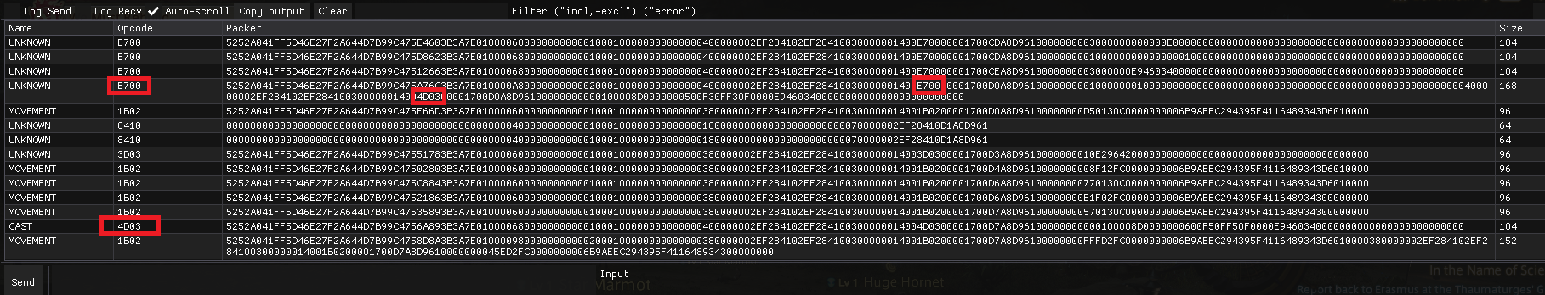
Dissecting the protocol

Slide 18
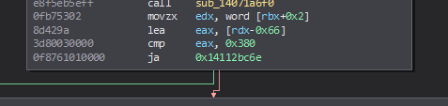
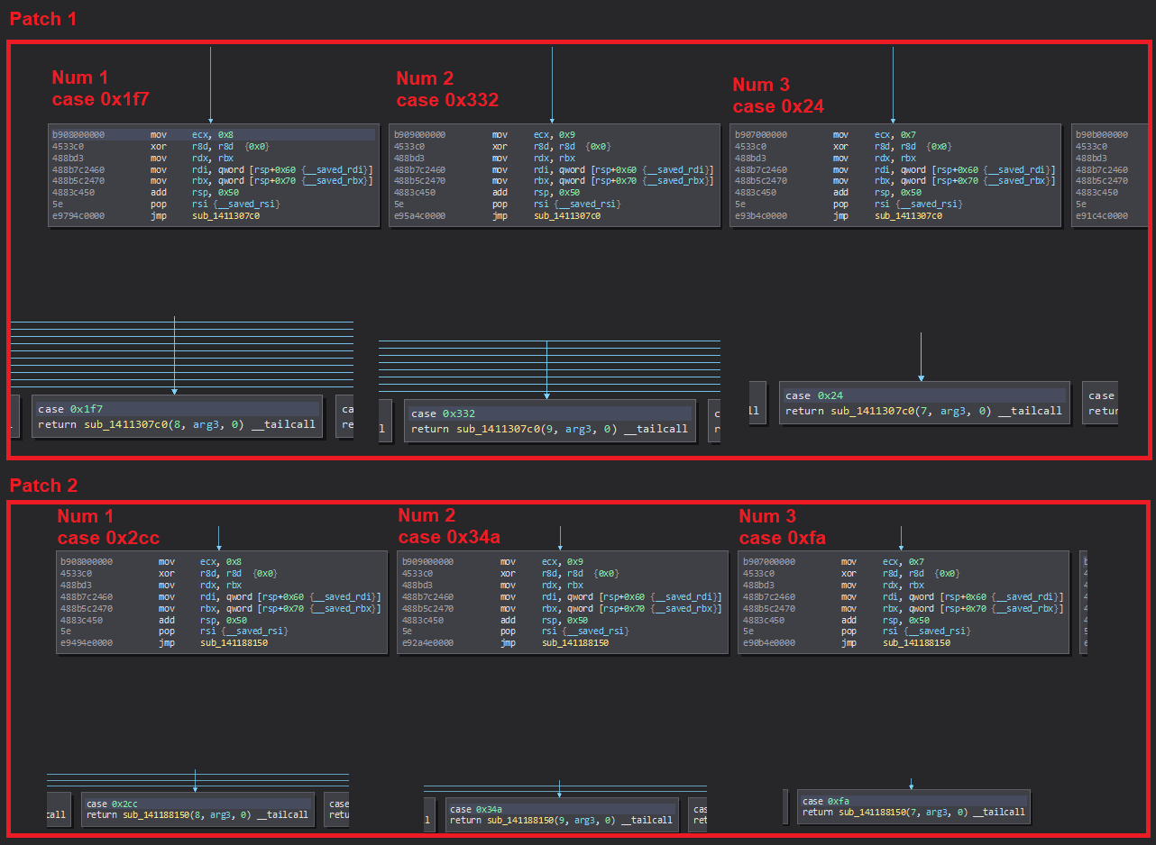
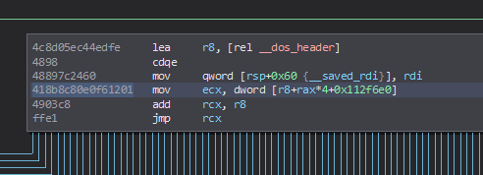
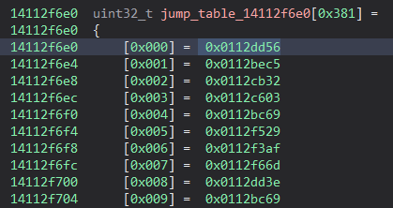
Autoupdating the packet IDs

Slide 19
Conclusion
Can enhance the game experience for singleplayer games
Bad for online games integrity
Don’t hurt the player experience
Don’t hurt the companies bottom line

